Slide 1


ExtraBees²
VAST 2013 Mini-Challenge 3
Maarten Bieshaar Richard Borkowski Sijia Li Andreas Stavropoulos
Notes:
Hello und bla bla
Richard cannot attend for private reasons

Slide 2
Agenda
Introduction/ Live Demo
Internet/Server communication
Data and data model
Visualization transformation
Visual Information Seeking Mantra
Visualization: Network flow
Intranet communication
Data preprocessing
Visualization: Bubble cloud
Notes:
divided the group in two subgroups (kind of Macro-/ Micro-View)
But first start with general introduction.
- the Marco-part which we about Richard and my part .
- That means - Our (Visualization-)Mantra and our target- The data and how Richard and I chose the data model etc.
- then Sijia and Andreas tell about the Micro-View on the data -
- Their Data preprocessing and their visualization
- Finish our talk with a small live Demo.

Slide 3
Internet/ Server Communication
Maarten Bieshaar
Richard Borkowski
Real World
Visual Information Seeking Mantra:
Overview first, zoom and filter, then details-on-demand
by Ben Shneiderman (1996)
Data
Pictures
Primary Objective:
User (e.g. admin) should quickly find, identify and analyse problems in order to fix them.
Viewers
Notes:
to visualize such a huge dataset => oriented on the visual information seeking mantra by Ben Shneiderman
TARGET/ AIM: THE NETWORK ADMINISTRATOR
to fulfill our goal of creating a visualization where network admins can quickly find, identify and analyse problems
after this quick introduction, which has explained the Real World part of the “mindset?”, i

Slide 4
Data and Data Model
Network of company with three Sites
network traffic and health data.
Data model: network topology
nodes: 3 enterprise sites and internet
edges: connection between sites & internet
Time-dependent network traffic
Data model: time-dependent qual./ quan. health data per Server/ Site
Integration via relational model
relational Databases (e.g. MySQL)
Data Processing/ Transformation
filtering/ cleansing: e.g. splitting long entries
abstraction: e.g. use of fixed time intervals
extraction: traffic/ health per enterprise site
Real World
recordings network activity
"Raw"data
SQL
Analytical
Abstraction
according to
Chi (2000)
Notes:
Do not forget to mention that the visualization should also be used in realtime i.e. with other data => possible due to flexibility given by SQL-Server.

Slide 5
Visualization Transformation
Visualization Transformation:
Query database to generate time-dependent visualizable network status.
e.g. overall traffic load or no. errors/ warnings/ connection timeouts
Visual mapping:
mapping of extracted data to visualization
e.g. time-dependent traffic amount to color and width of edges
Analytical
Abstraction
Visualization
Transfor-
mation
Visualization
Abstraction
Visual Mapping
View

Slide 6
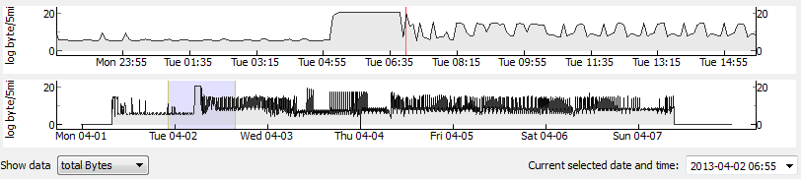
Visual Information Seeking Mantra:
Overview, zoom, filter
lower plot shows overview
upper plot shows move- and scaleable region of the lower plot
accurate time selection with date field and pop-calendar
different data sets selectable with combo box

Slide 7
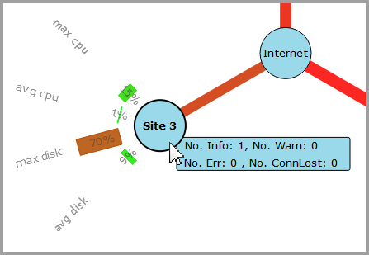
Visual Information Seeking Mantra:
details-on-demand
mouse-hover shows radial oriented bars with information about health values
mouse-click on a site node locks the visibility of these health values in order to observe changes
double-click switches to detailed site-view

Slide 8
Intranet Communication
Sijia Li
Andreas Stavropoulos
Data preprocessing
Bubble scene

Slide 9
Data preprocessing
mySQL is used for
Reduce the amount of the dataset so the visualization can run in real time
calculate the total workload of every workstation in the company in every 5 minutes interval
views were used for the calculations
finding the status health value of workstations in every 5 minute interval

Slide 10
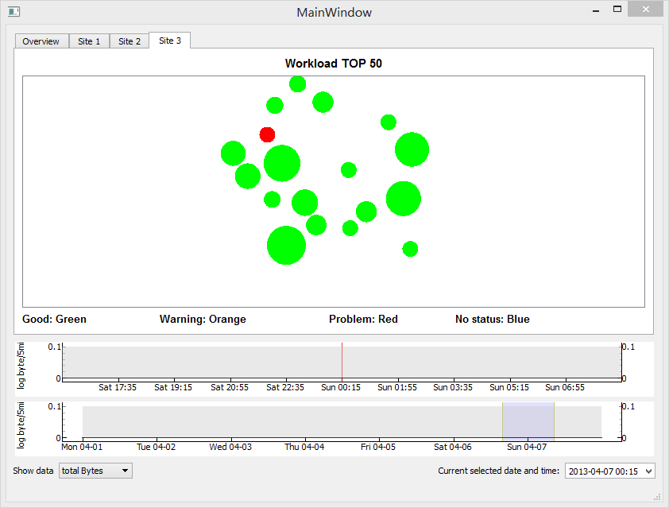
Bubble Scene
Fetch and preprocess data from mysql
Atomic Bubble
Mouse Hover Event
Bubble Animation
Resize
Relocate
Color Change
Bubble Scene
Initialize Scene
Keep Tight Algorithm
Synchronize time stamp with overview tab

Slide 11
References
Shneiderman B. (1996). The Eyes Have It: A Task by Data Type Taxonomy for Information Visualizations.
Chi Ed. H. (2000). A Taxonomy of Visualization Techniques Using the Data State Reference Model.

Slide 12
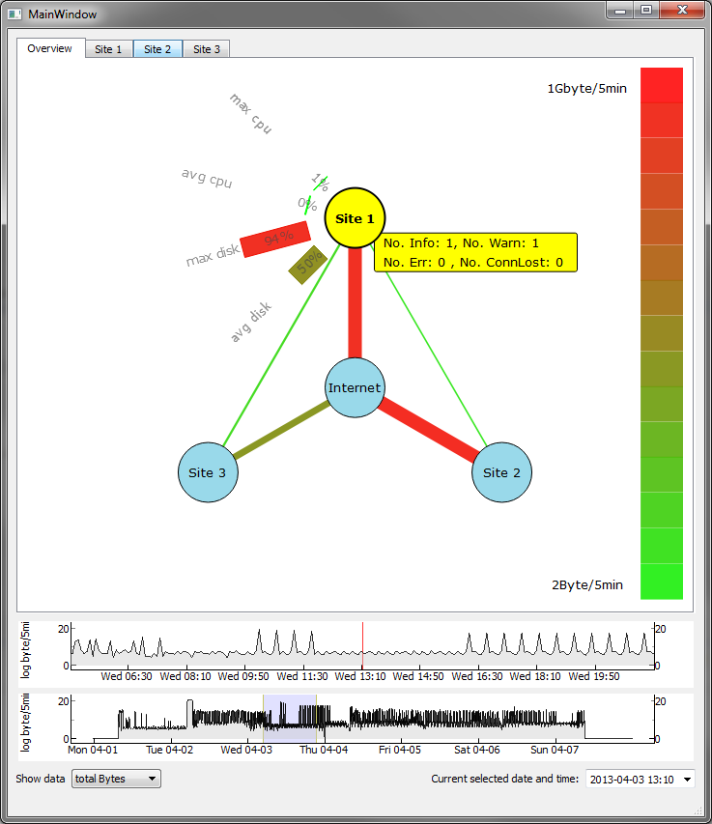
Visualization: Network flow
GUI and network flow visualization written in Python 2.7 using PyQt4
Flexibility and Extensibility due to use of MySQL Server
different views on data
PyQtGraph-library for real time data plots
quick zooming and region selection
Notes:
Nicht vergessen zu erzählen, dass wir hier bei der Architektur darauf geachtet, dass das Tool erweiterbar ist und durch die MySQL-Datenbank mit beliebigen anderen neuen Daten "gefüttert" kann.

